Slide 1

STATUS REPORT
Team Name: Sharktooth Software
Team Members: Alexandru Cioanca, Andrew Dutton, Dustin Phan​, Gabriel Molina​, Roberto Carvalho Brigagao, Thuan Nguyen
Date: 11/21/2024

Slide 2
Metrics* Table *A software metric is a measure of software characteristics that are quantifiable or countable. Software metrics are important for many reasons, including measuring software performance, planning work items, measuring productivity, and many other uses. NOTE: Study each Metric’s definition and determine whether is is applicable to your project
 | Week 1 | Week 2 | Week 3 | Week 4 | Week 5 | Week 6 | Week 7 | Week 8 | Week N
CPI | 1 | 1 | 1 | 1 | 1 | 1 | 1 | 1
RCM (Business Application) | 10% | 10% | 10% | 10% | 10% | 10% | 30% | 30%
Error Density | N/A | N/A | N/A | N/A | N/A | 10% | 30% | 50%
MTTF | N/A | N/A | N/A | N/A | N/A | N/A | N/A | N/A
MTTR | N/A | N/A | N/A | N/A | N/A | N/A | N/A | N/A
AVAIL. | N/A | N/A | N/A | N/A | N/A | N/A | N/A | N/A
SMI | 0% | 0% | 5% | 5% | 5% | 10% | 20% | 25%

Slide 3
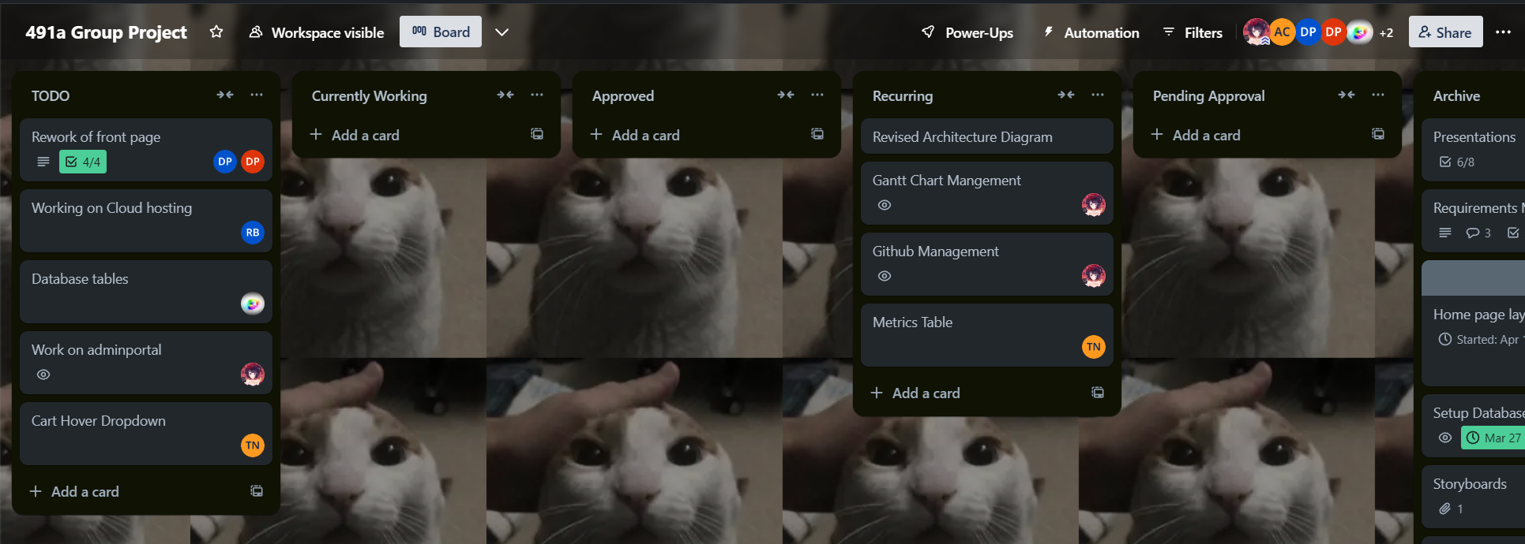
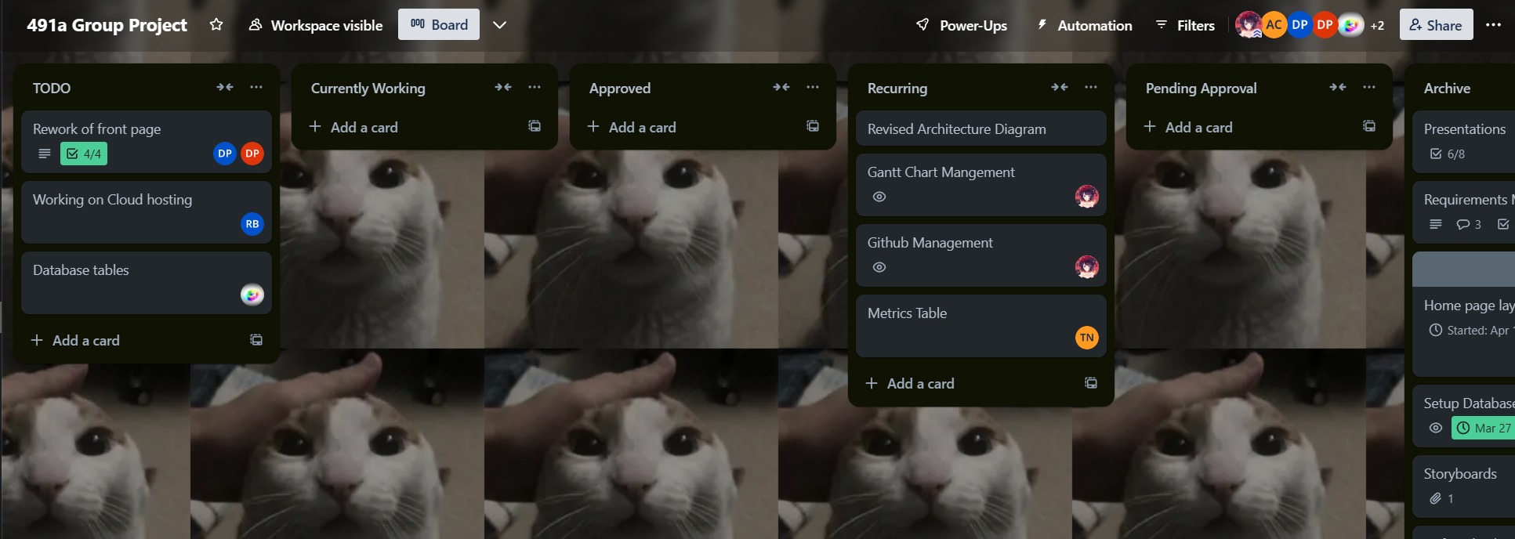
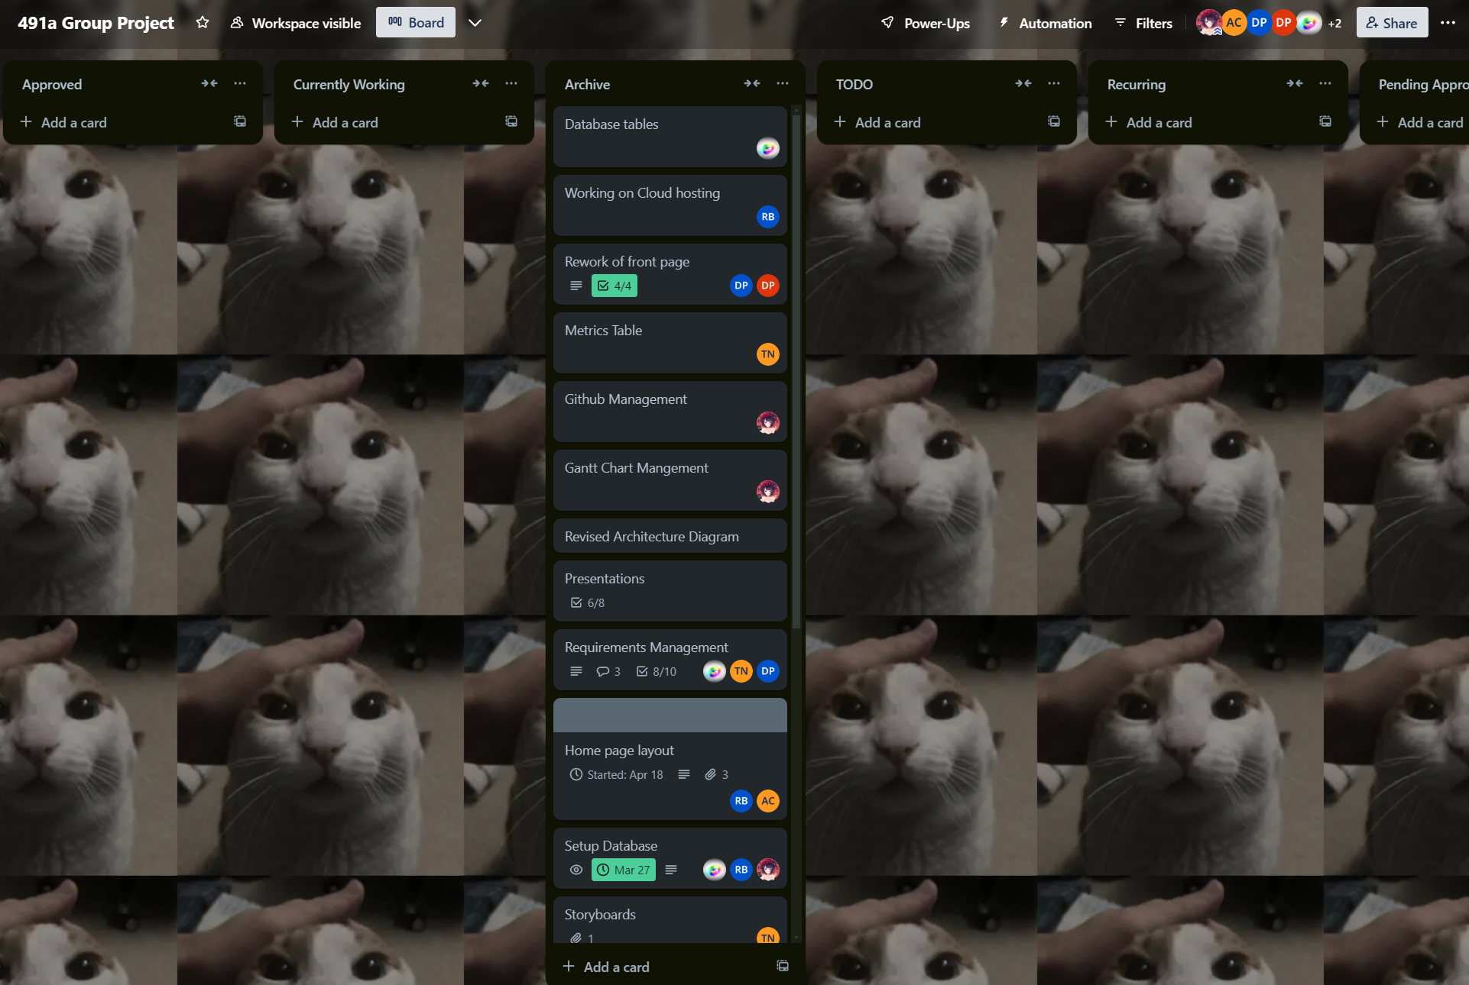
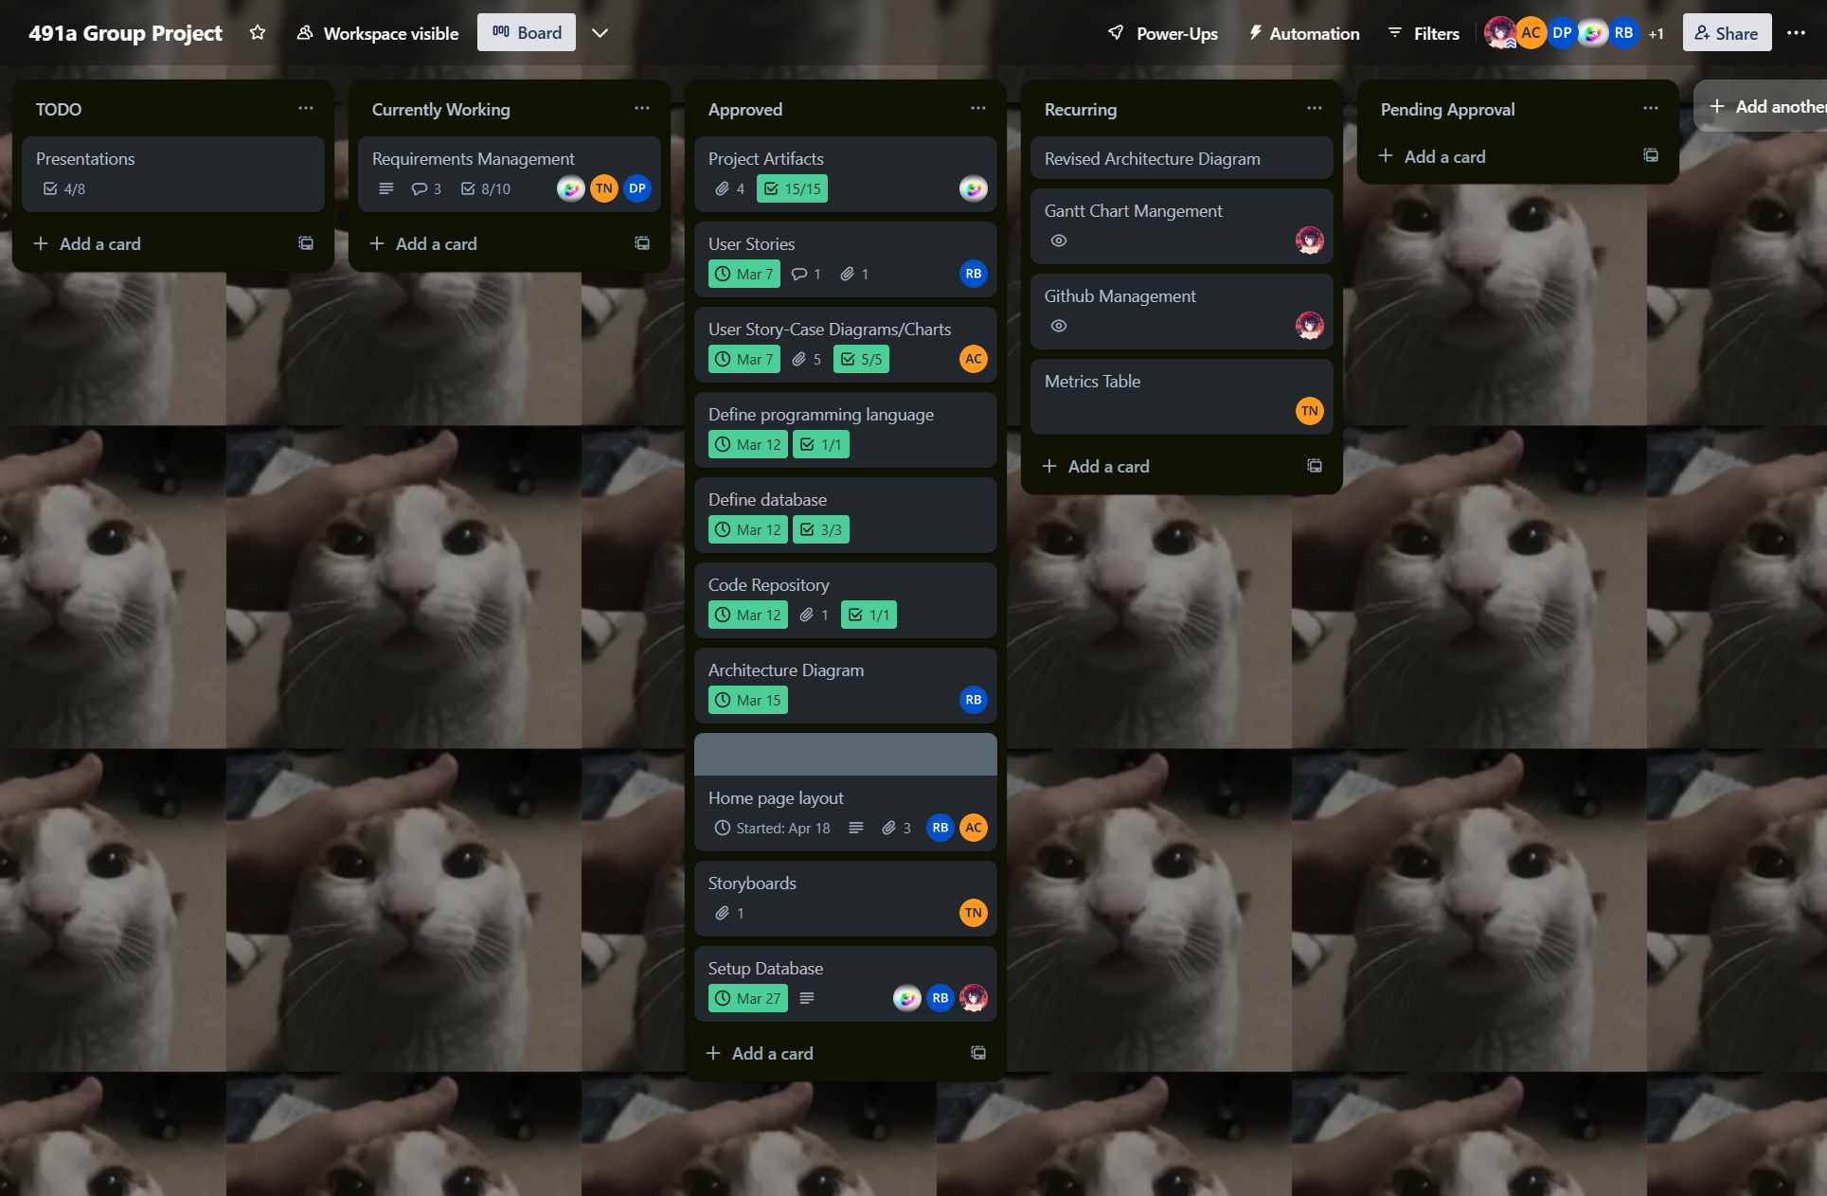
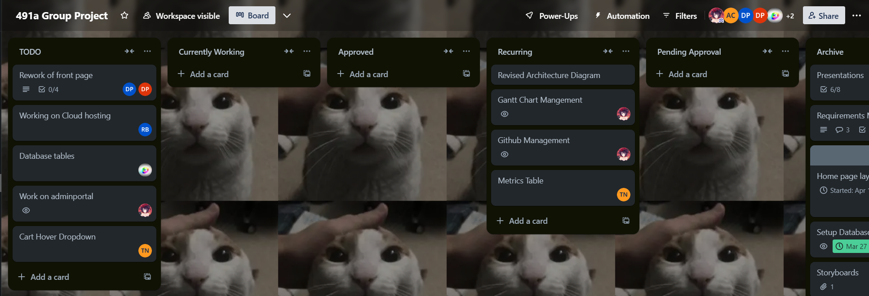
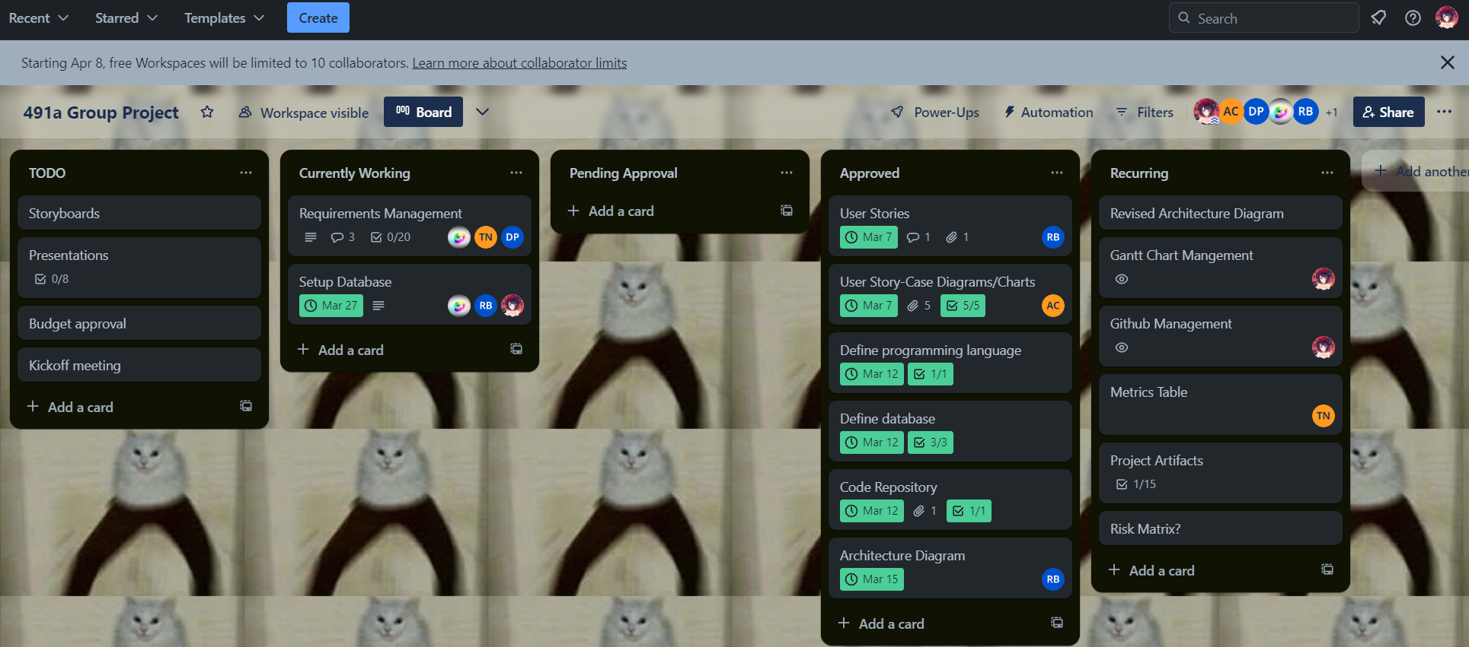
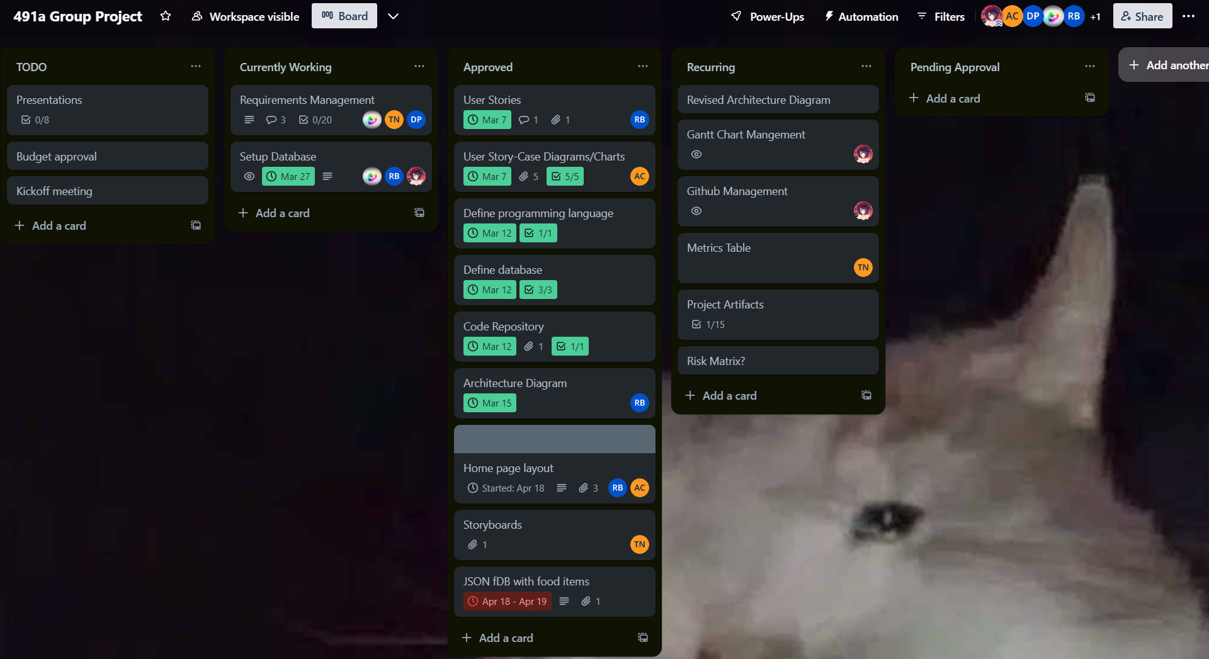
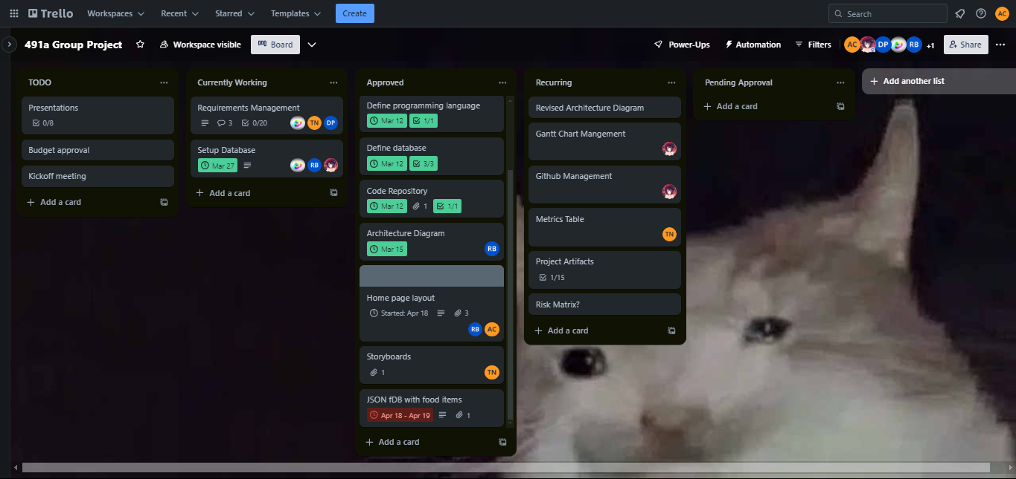
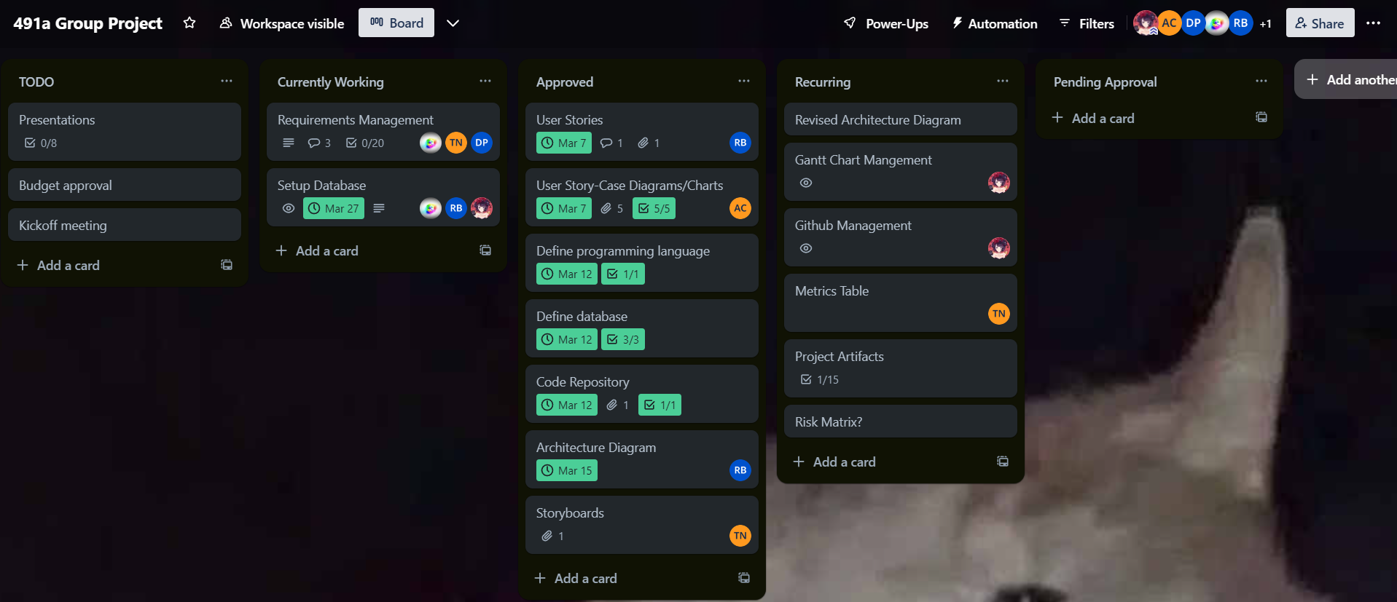
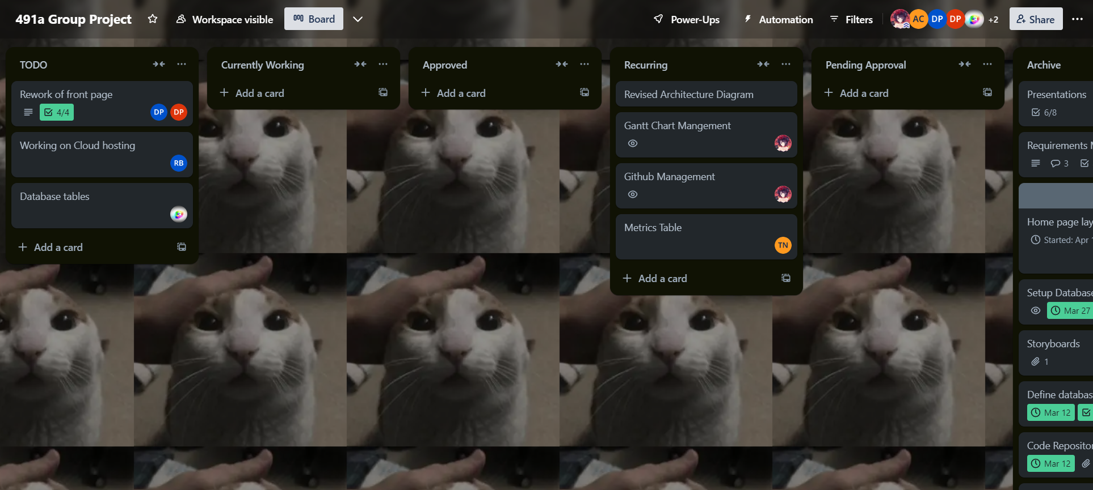
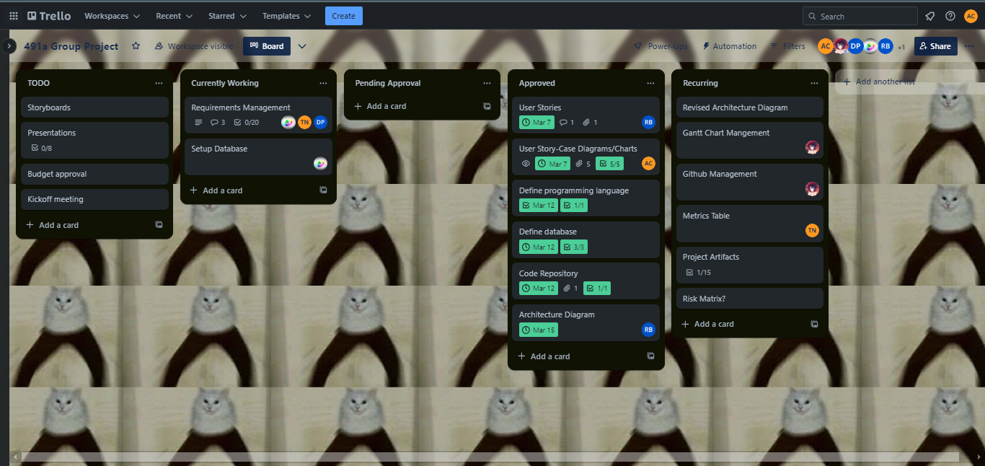
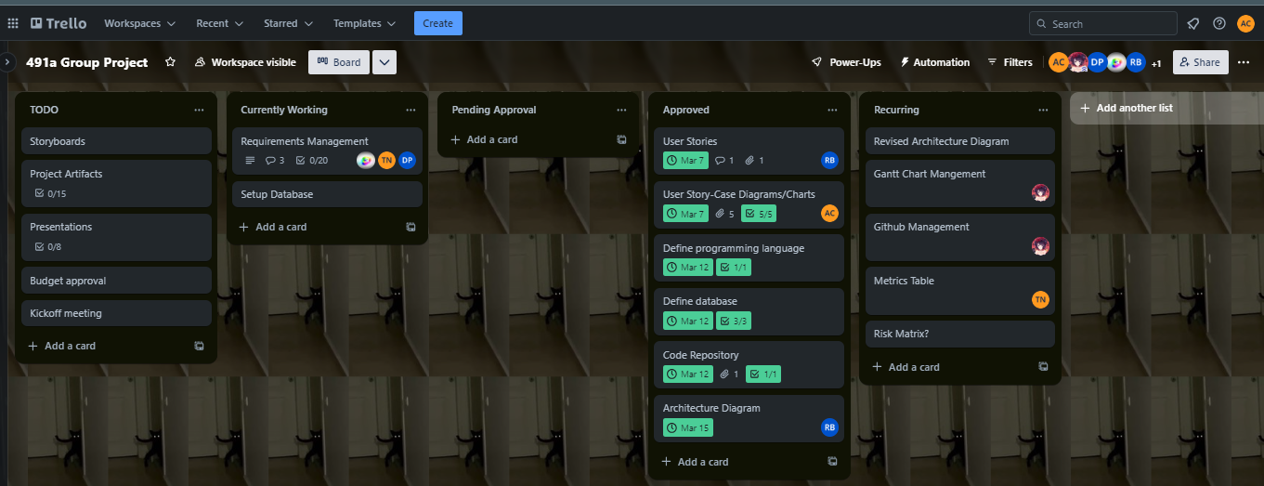
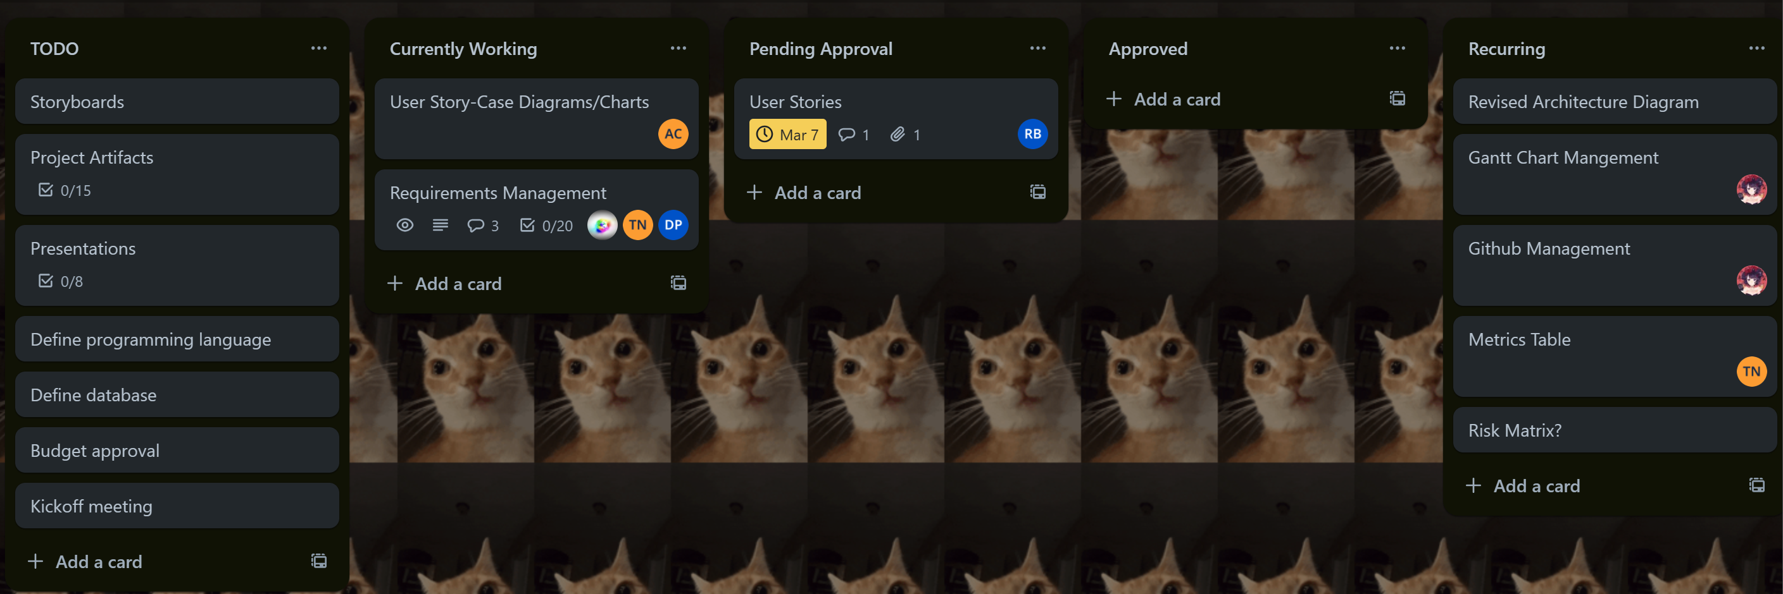
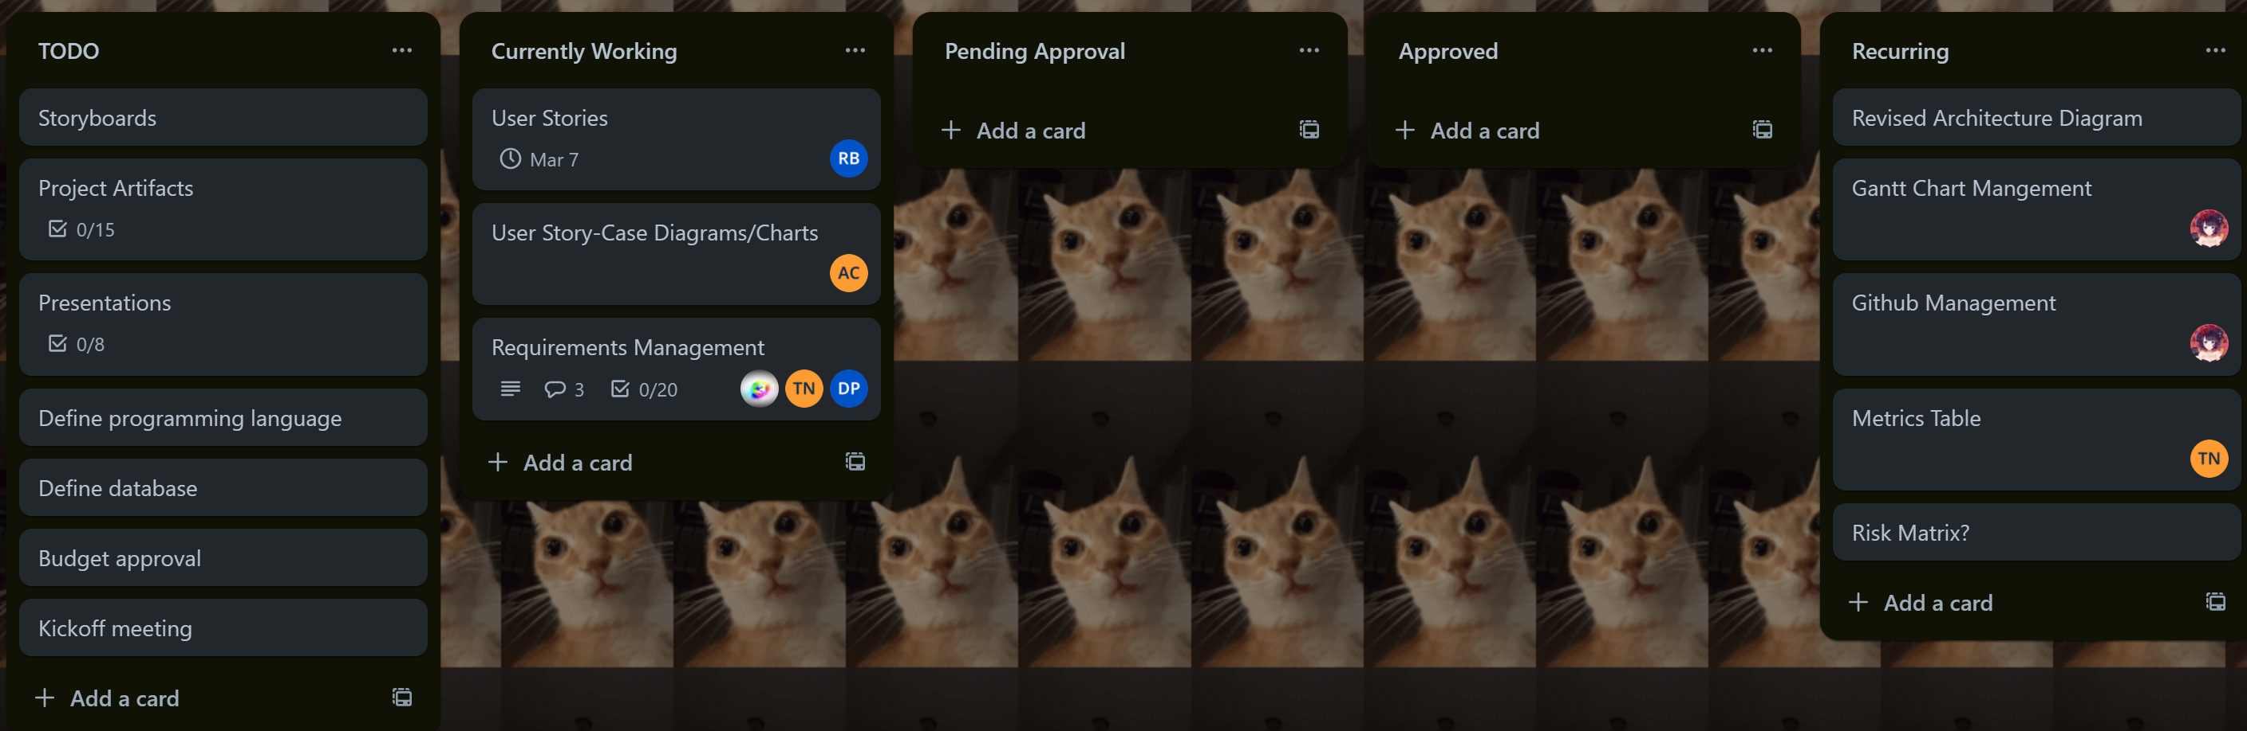
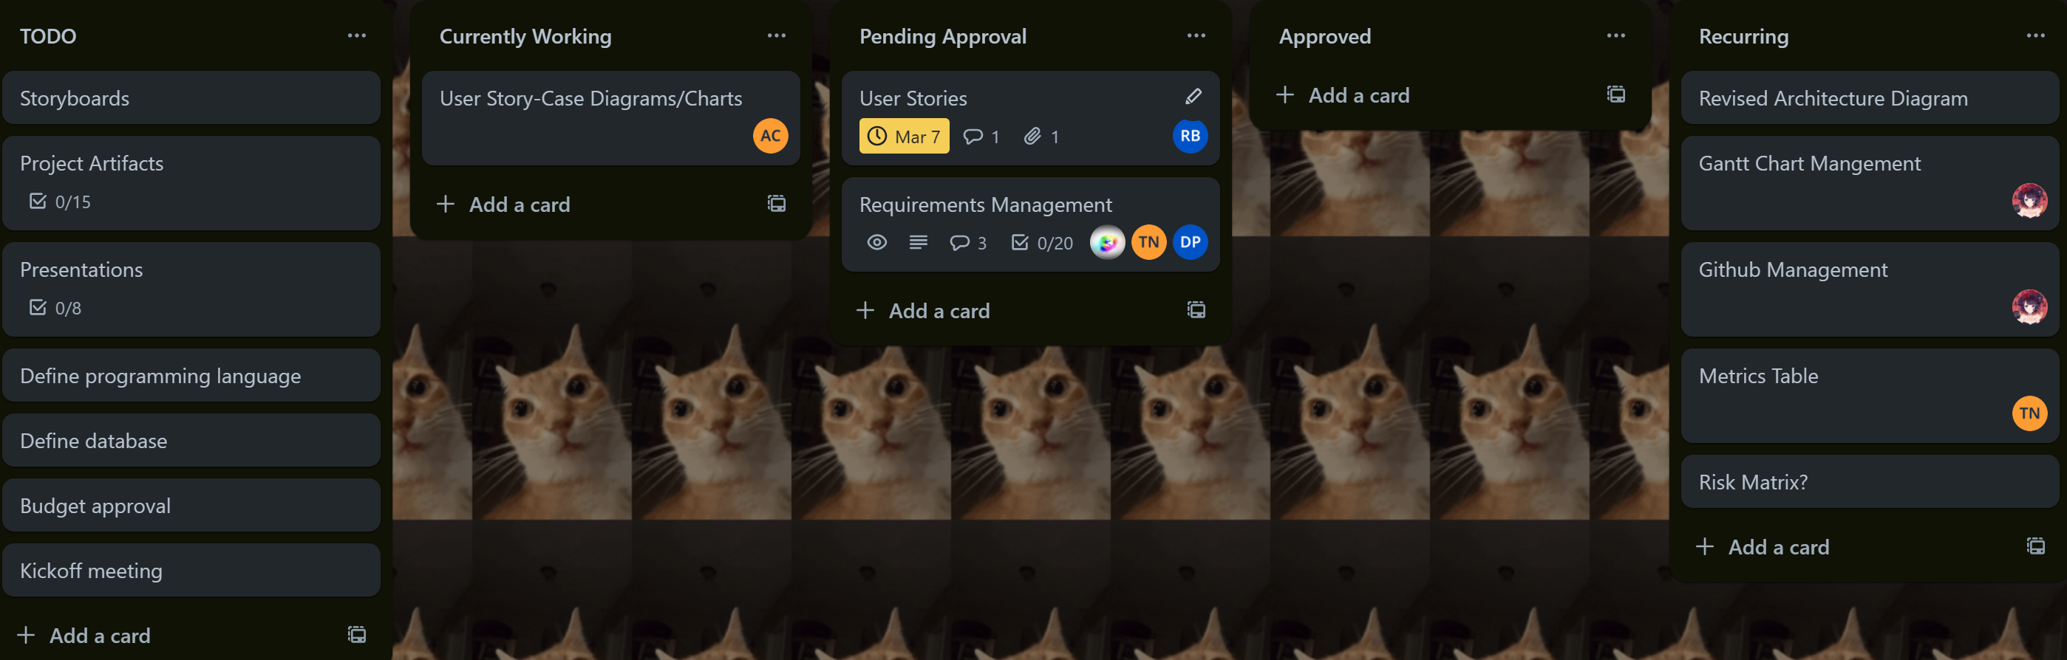
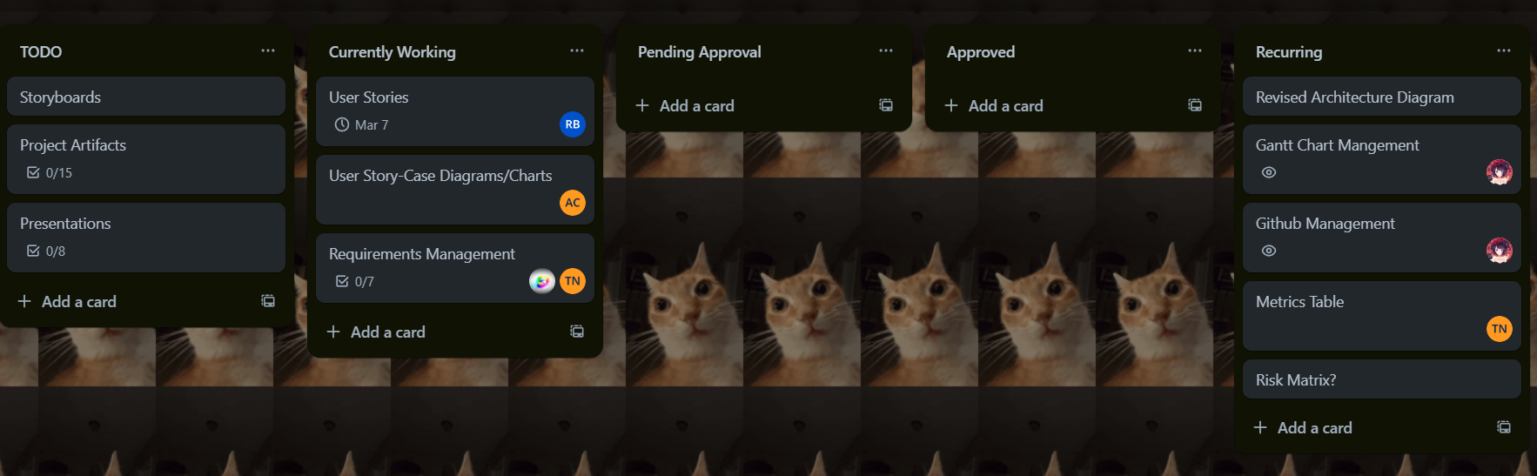
Integrated Schedule (Pretty much done)

Slide 4
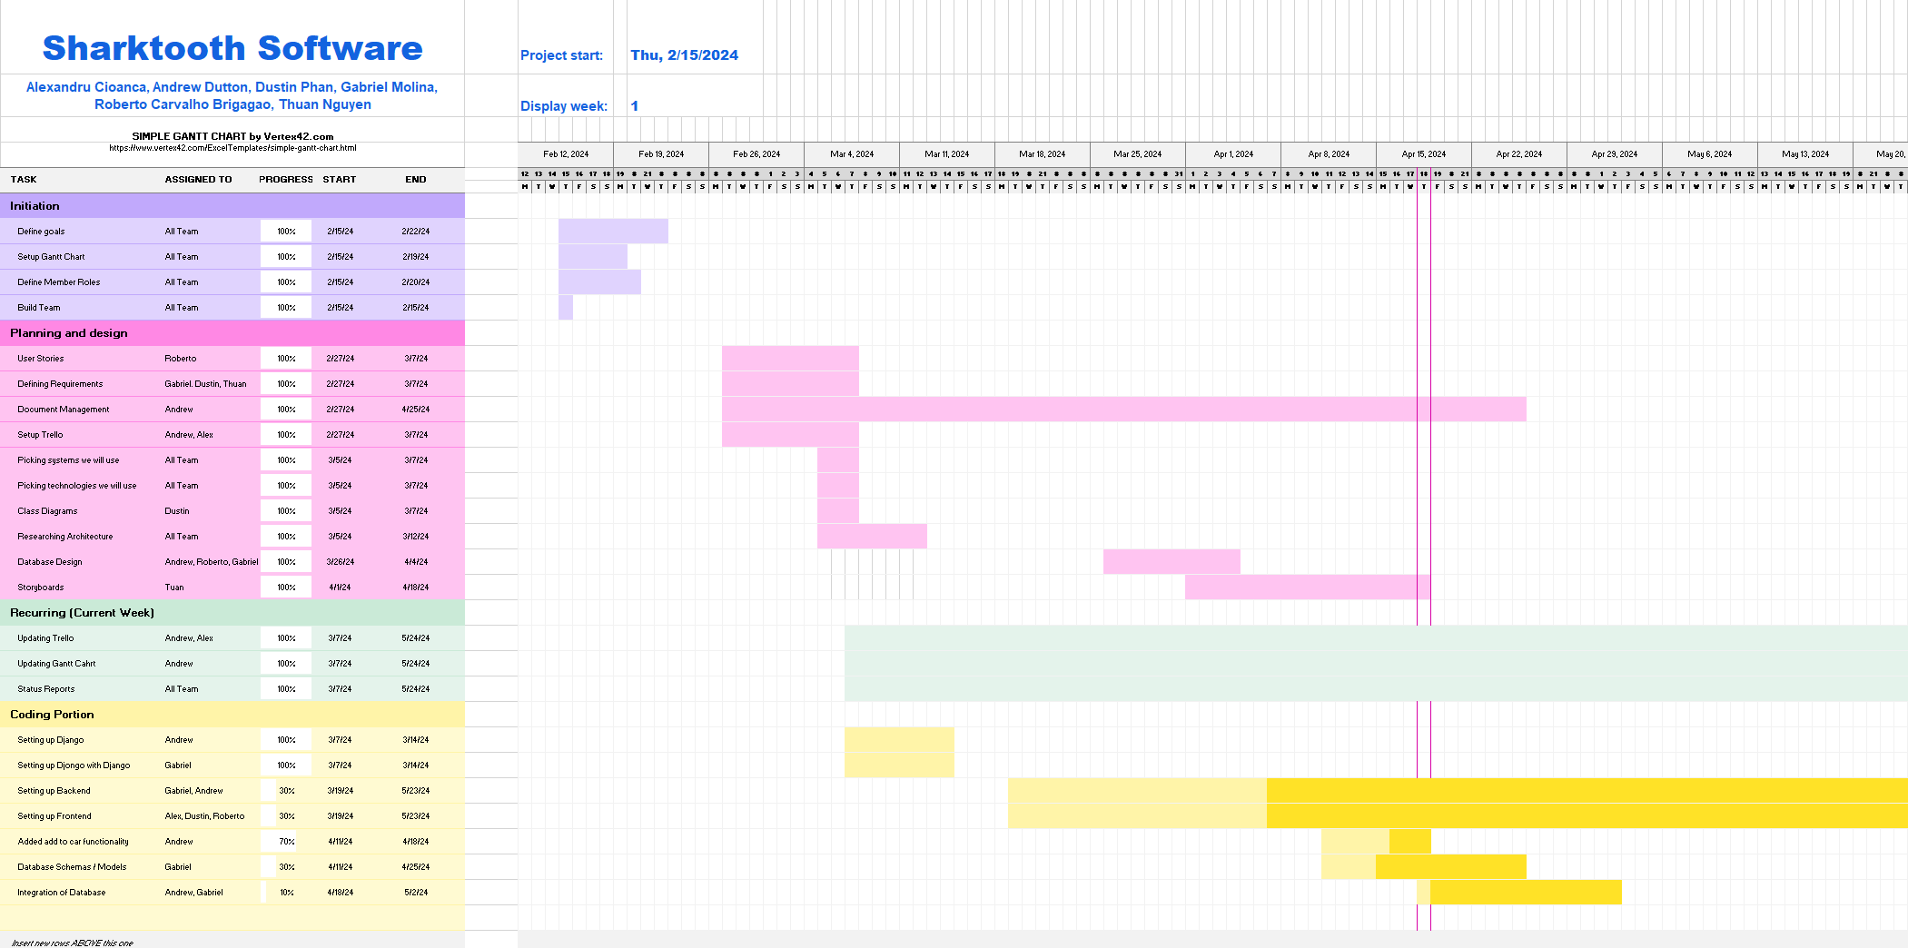
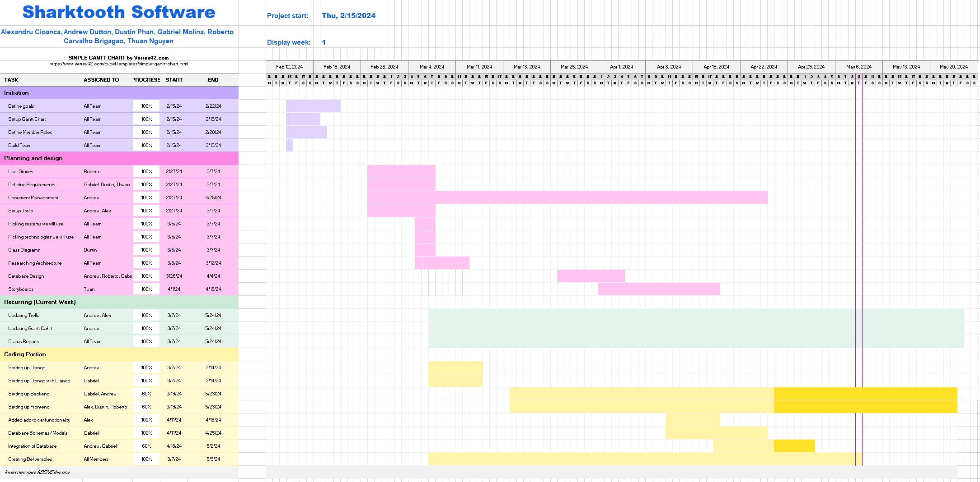
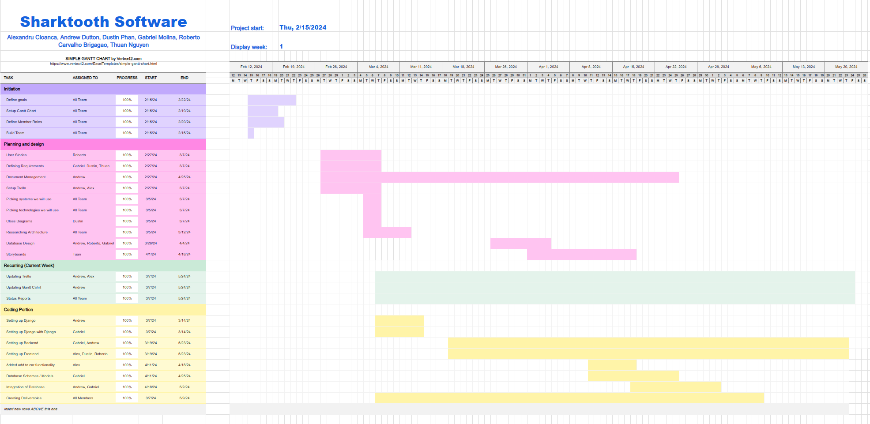
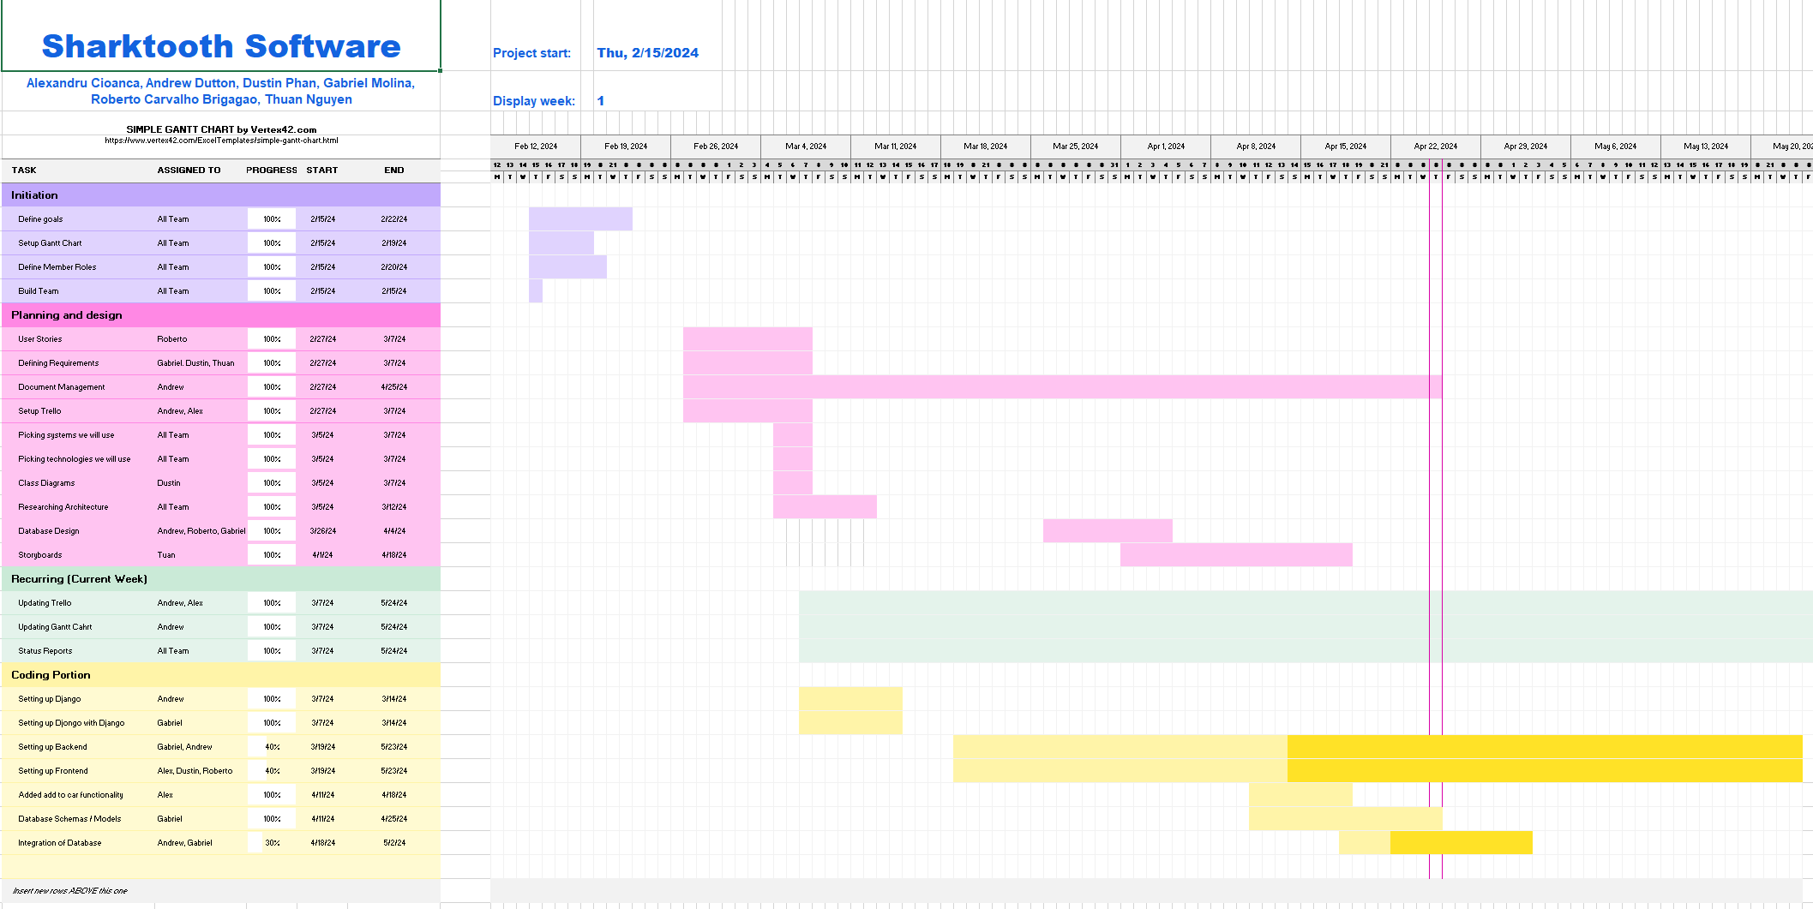
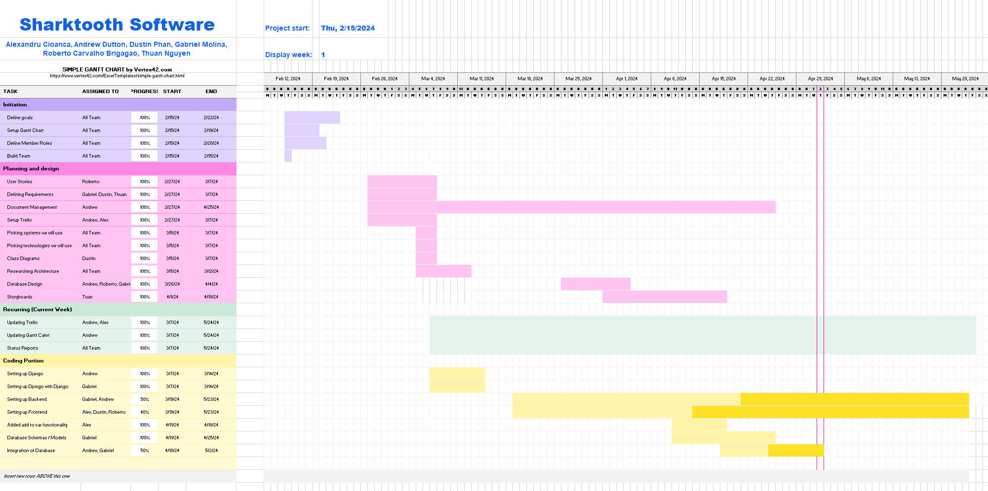
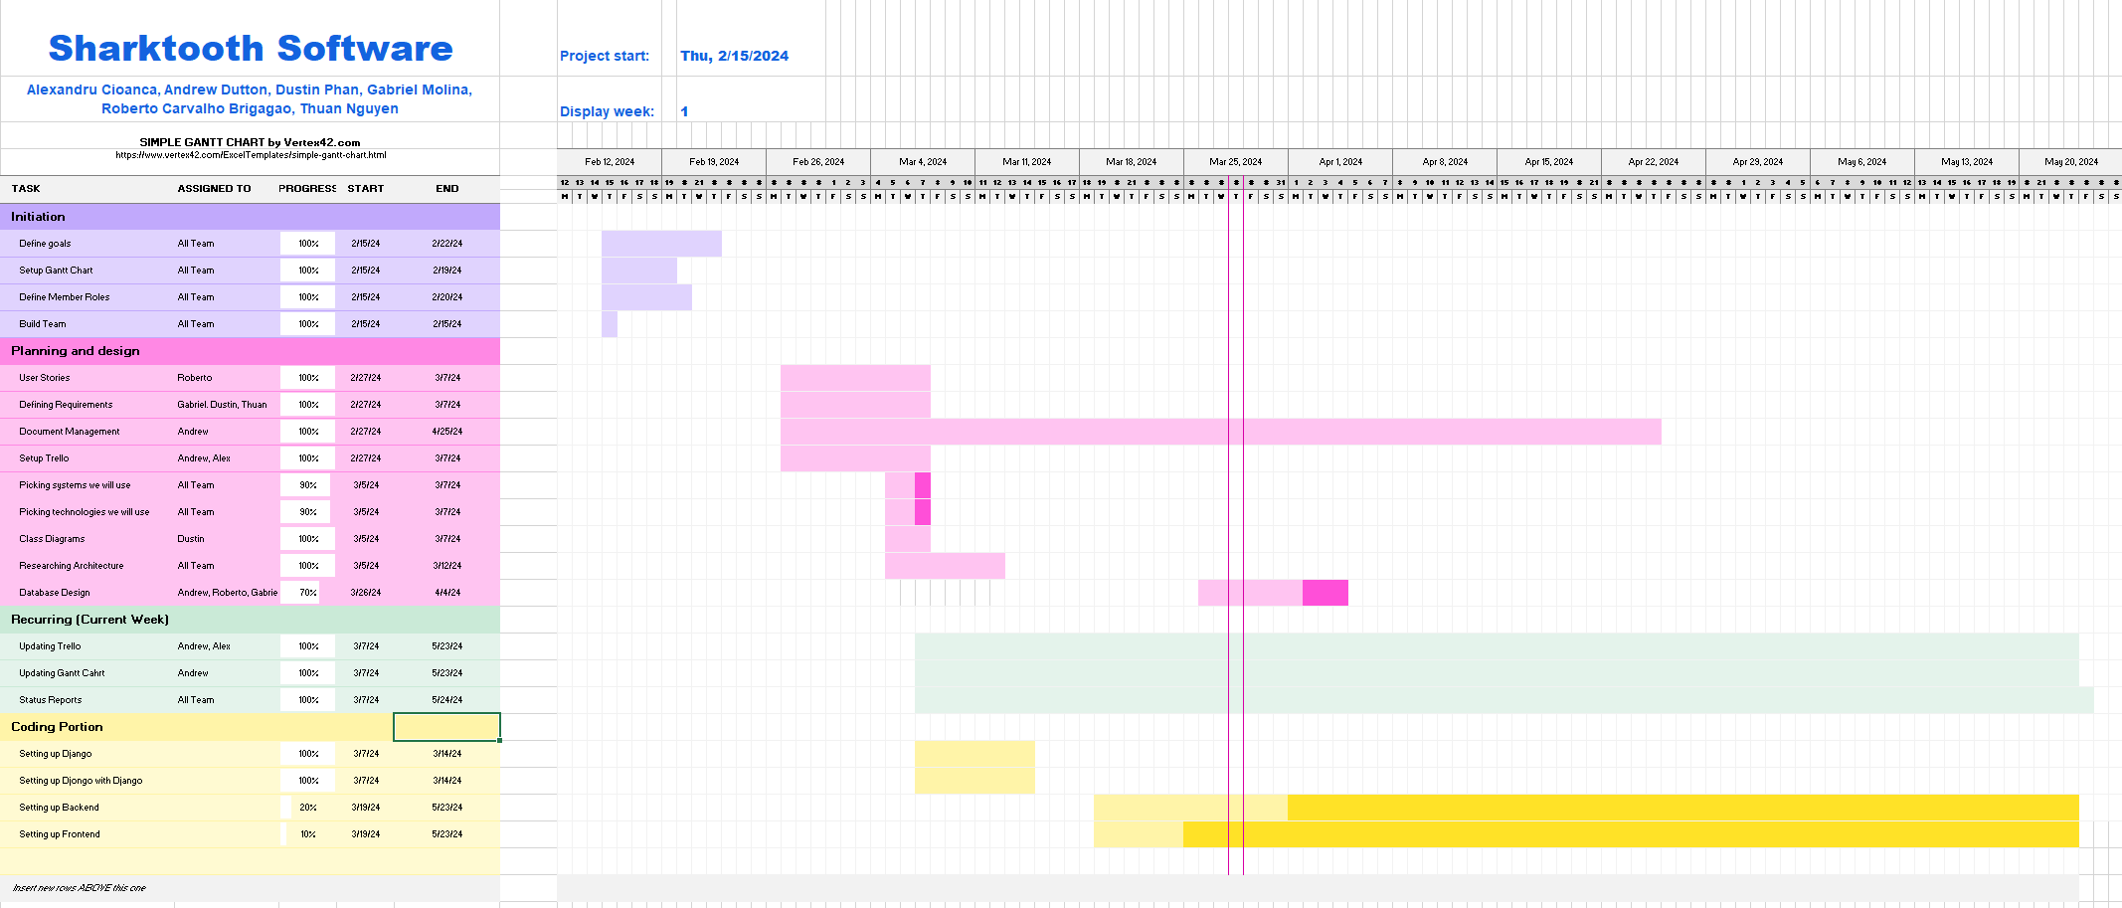
Gantt Chart 11/21/2024

Slide 5
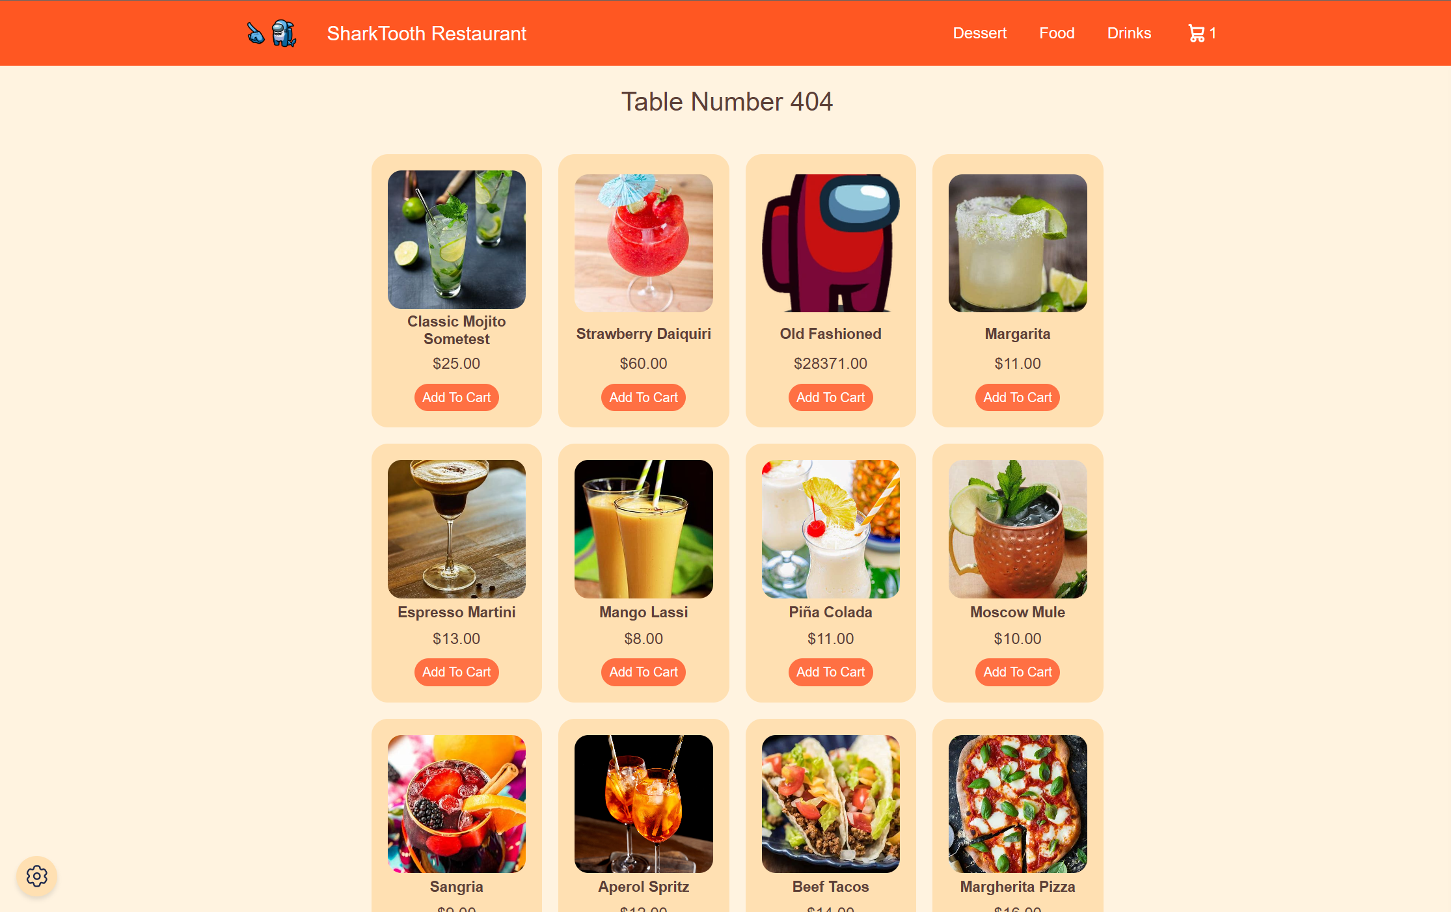
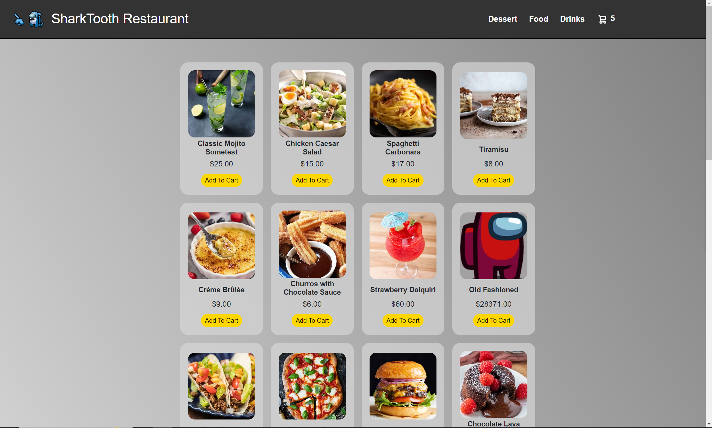
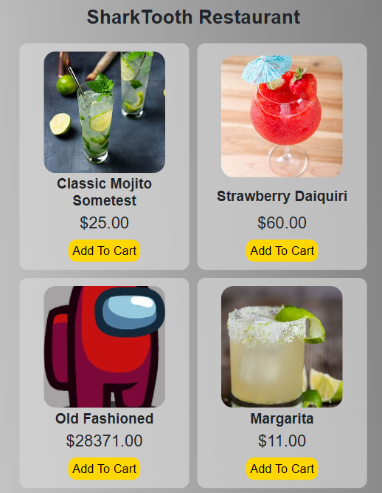
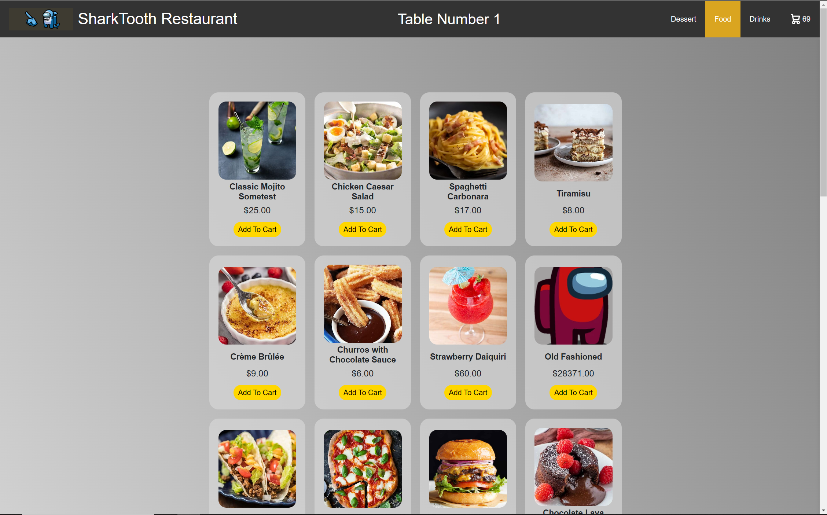
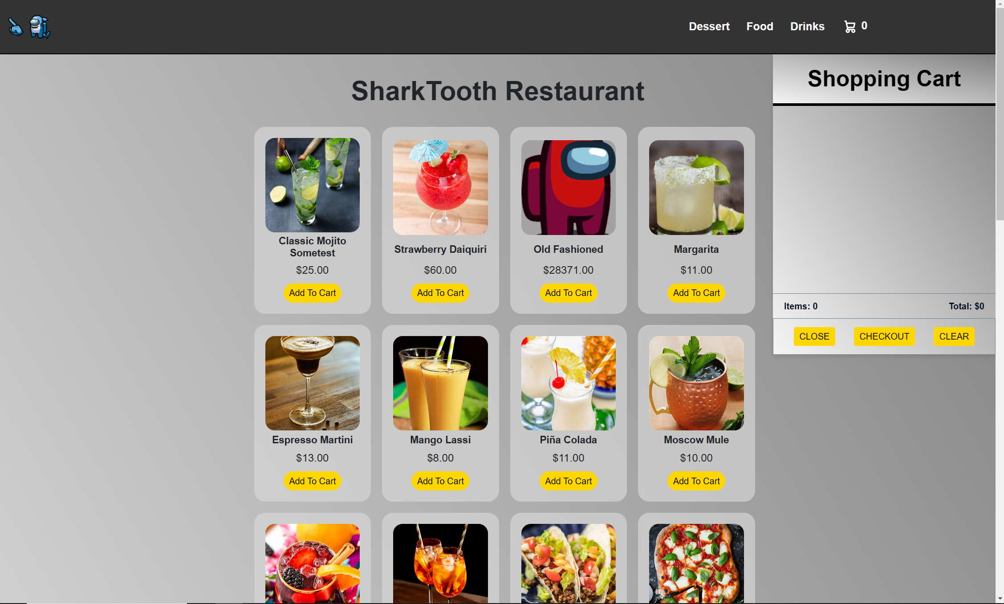
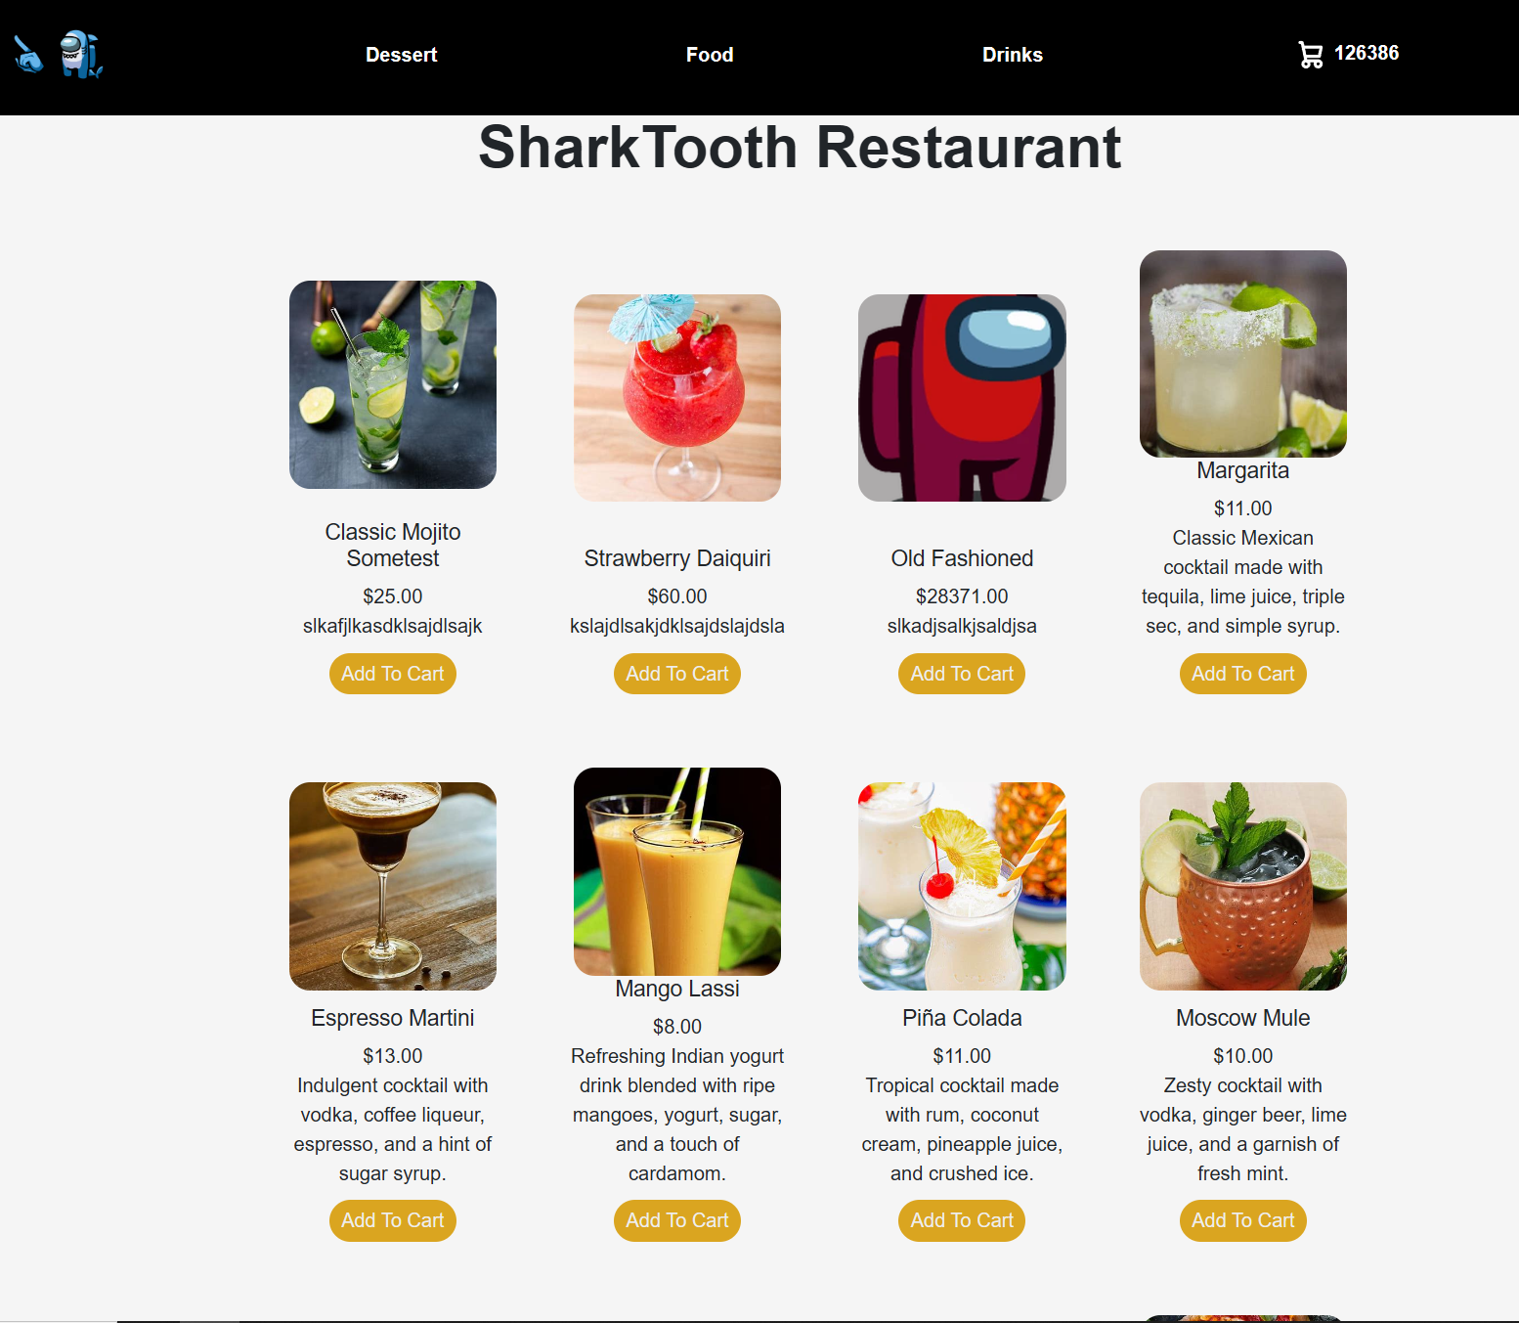
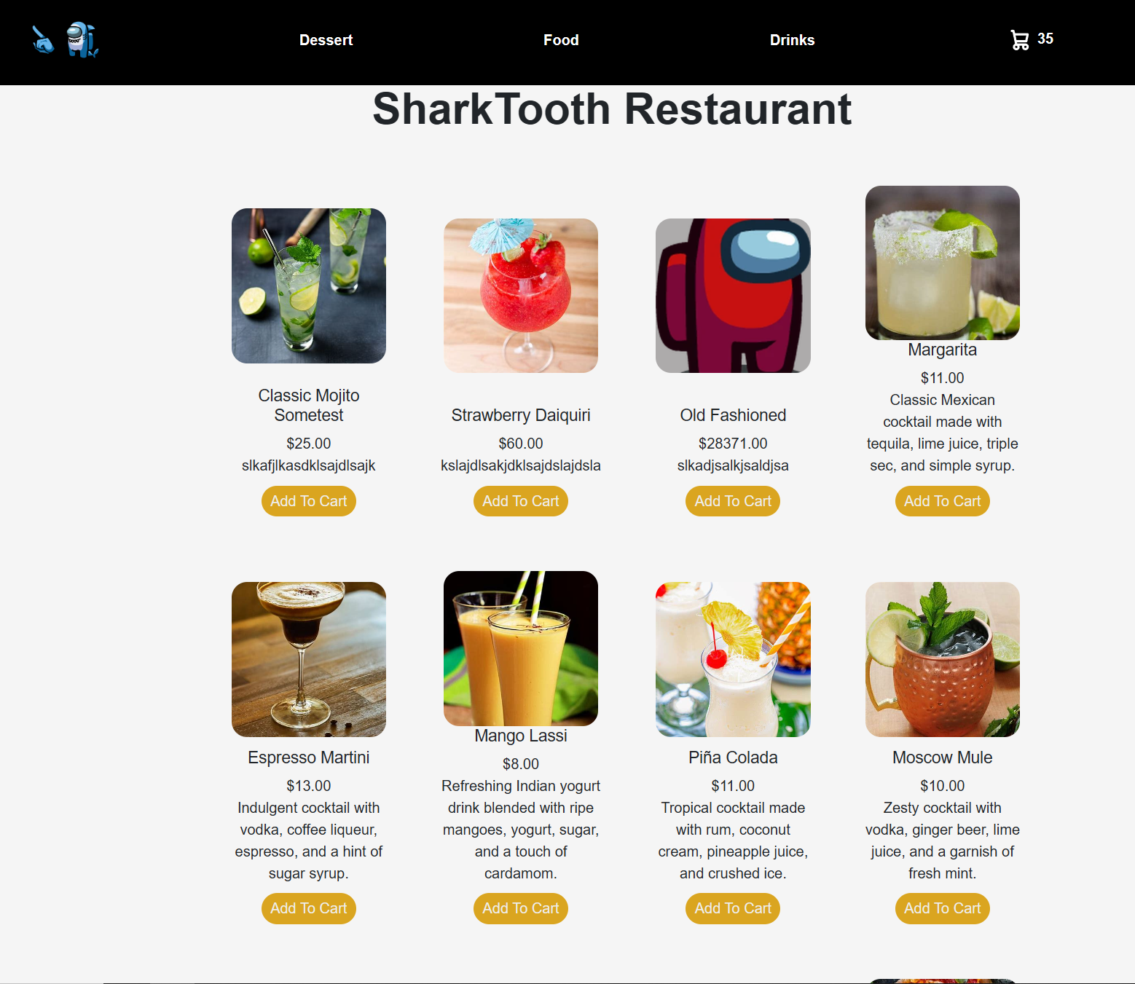
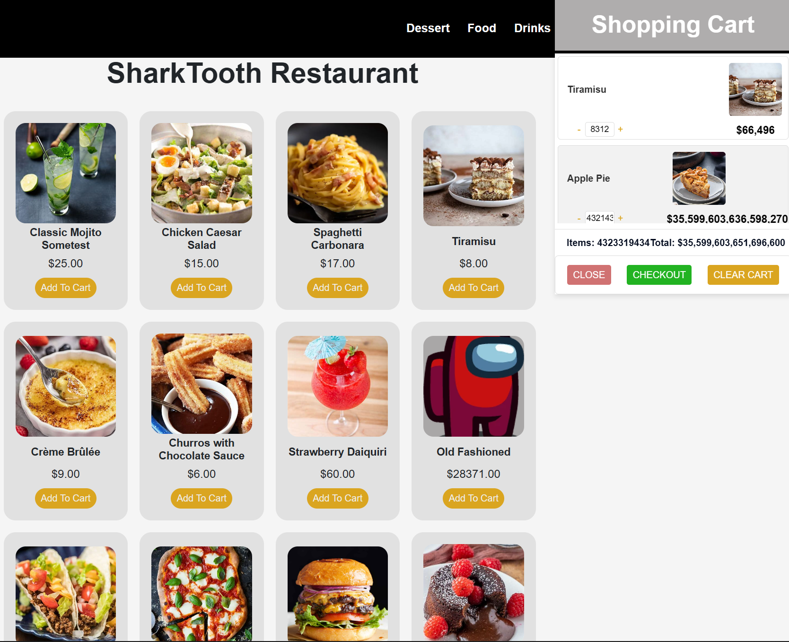
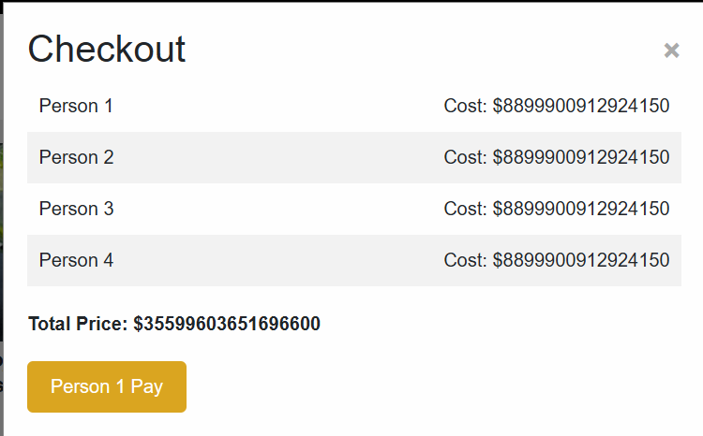
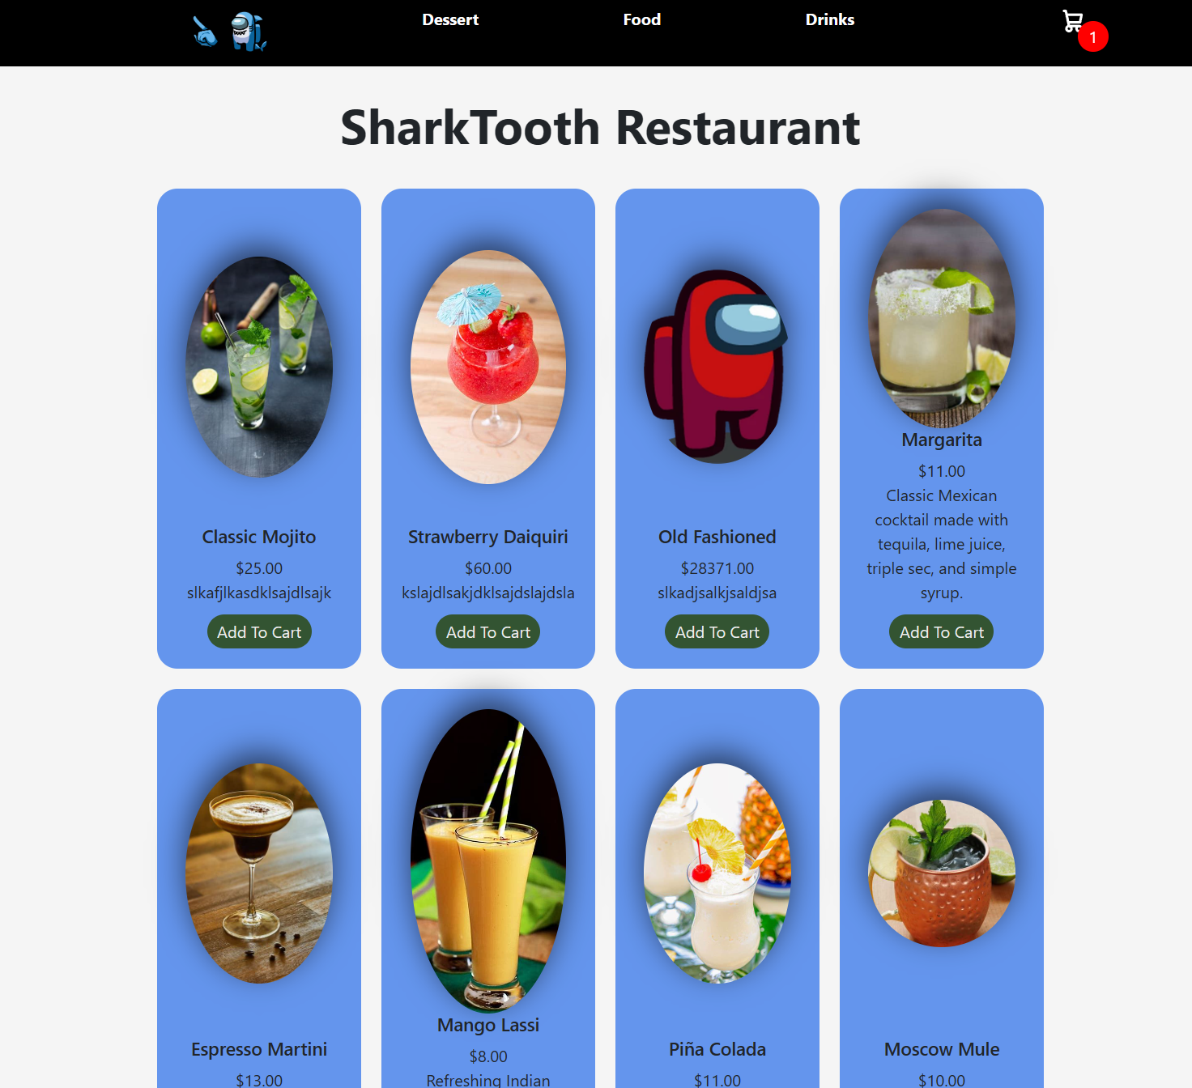
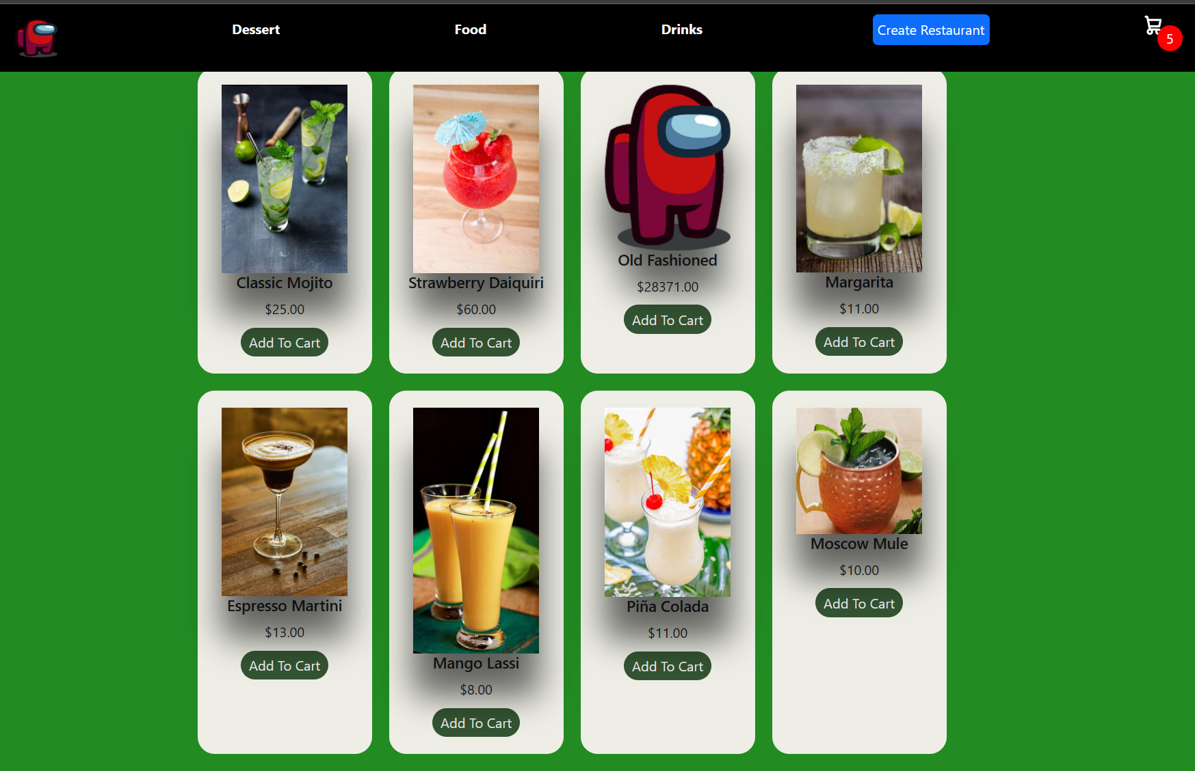
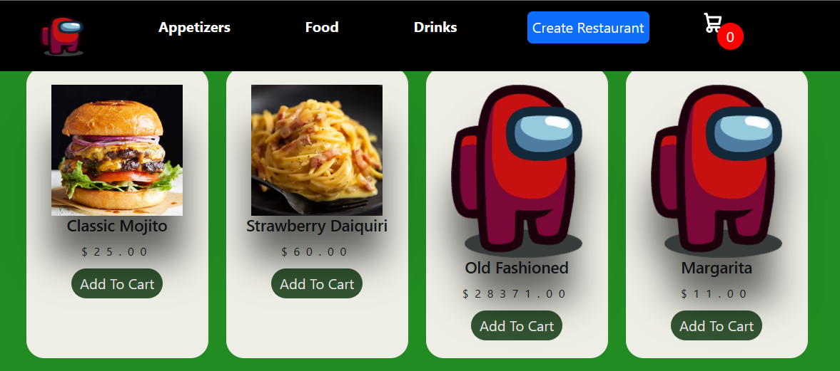
Main Menu Page

Slide 6
What Everyone is Working on - week 11/21/2024
Alexandru Cioanca
Helping with site design updates
Adding themes to the website
Andrew Dutton
Fixing small bugs
Working on updating the demo sldies
Dustin Phan​
Working on mobile site design
Gabriel Molina​
Finalizing backend
Adding themes to the website
Roberto Carvalho Brigagao
Double checking issue with site deployment
Thuan Nguyen
Working on mobile site design

